Slide 1


Group 1
Project presentation
Phytoplankton Air Systems
Dhairya Pal (N01576099)
Julian Imperial (N01638310)
Dharmik Shah (N01581796)
Sanskriti Mansotra (N01523183)
Algaerithms Inc.

Slide 2

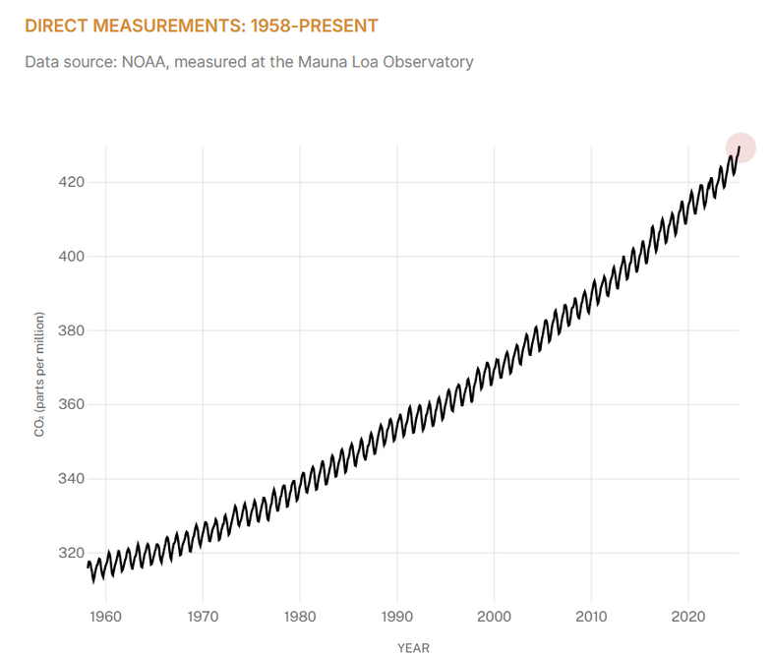
The Air We Breathe: A Growing Concern
“Air quality in Toronto among worst in world amid wildfire smoke“ - CBC, June 7, 2025
Notes:
Just last week, Toronto’s air quality dropped to unhealthy levels, with an AQI peaking over 100.
You could feel it — scratchy throats, irritated eyes, fatigue just from walking outside.
And yet, most people had no idea what they were breathing until it was too late.
Reality Check:
Poor air isn’t a future problem — it’s a right-now problem.
It’s in our cities, our homes, our offices.
Headline stat:
"On June 5, 2025, Toronto was ranked among the world’s most polluted cities."
Short context:
Wildfire smoke, urban emissions, and rising CO₂ levels are choking cities, including our own.
NASA has three projects that measure CO2 levels and they found out, and this is a graph I got from NASA's website, that it has increased by over 50% in the last 200 years.
Impact:
Air pollution is linked to respiratory illness, reduced quality of life, and ecosystem damage.
Why now:
We can’t keep relying on filters and fans. We need living, sustainable solutions.

Slide 3
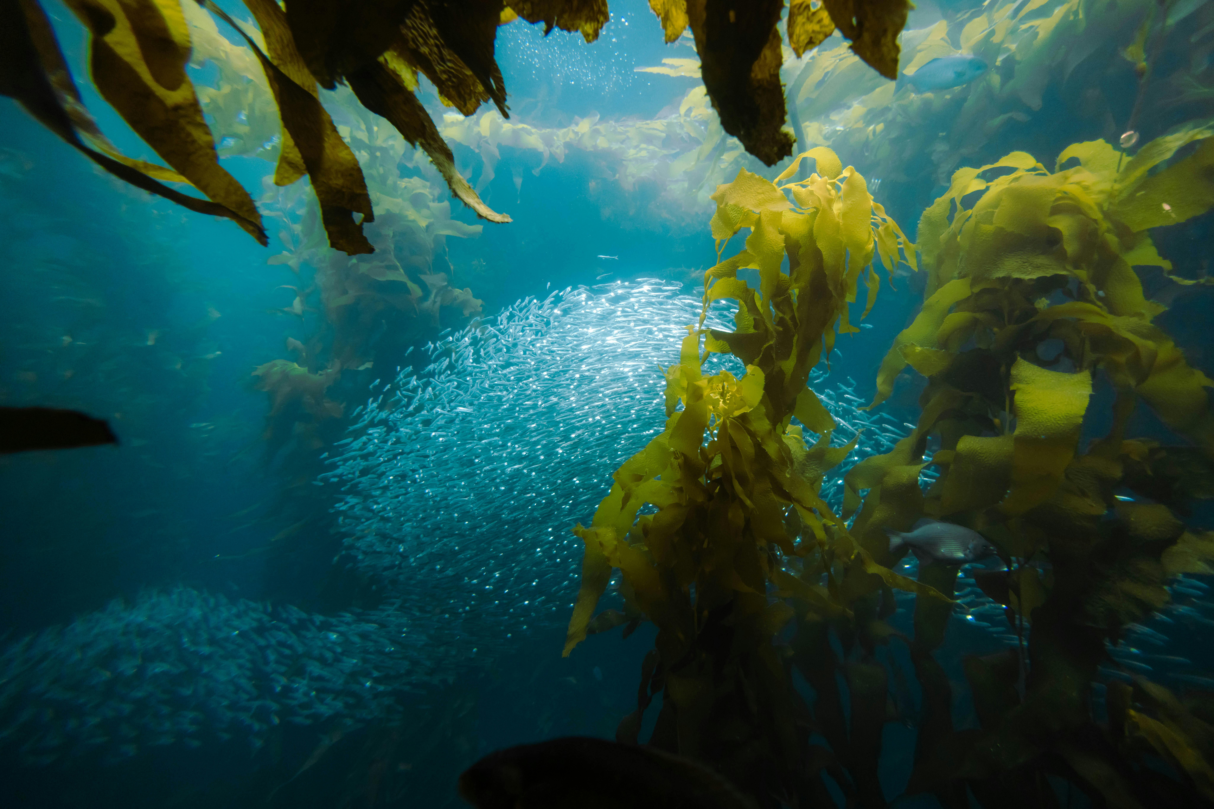
Our Living, Breathing Solution
Algae-based air purification tank
Monitors air quality in real time
Clean, modern interface showing:
Sensor readings (CO₂, AQI)
Sunlight, turbidity status, proximity
Notes:
“Our tank houses phytoplankton — the world’s biggest oxygen producers.”
“A steady water supply keeps them alive. A light sensor ensures they photosynthesize — even at night using custom LEDs.”
“We monitor turbidity to detect dying algae and CO₂ levels to measure oxygen output.”
“A proximity sensor creates a calming light-and-wave show when someone approaches — blending science and beauty.”
“All of this is tracked and controlled through our Android app.”

Slide 4
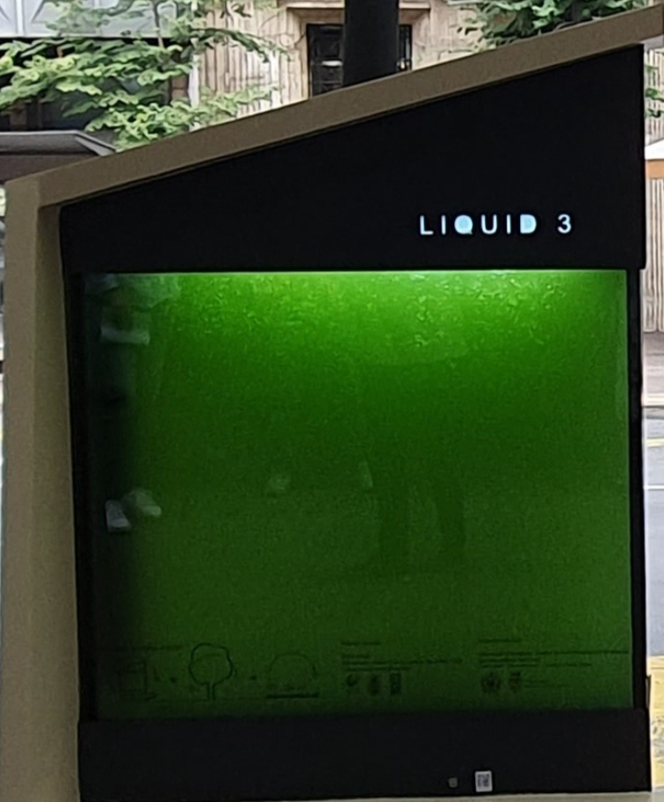
The Product
Water reservoir
Carbon dioxide sensor
Phytoplankton solution
Light sensor
Turbidity sensor
Proximity sensor

Slide 5
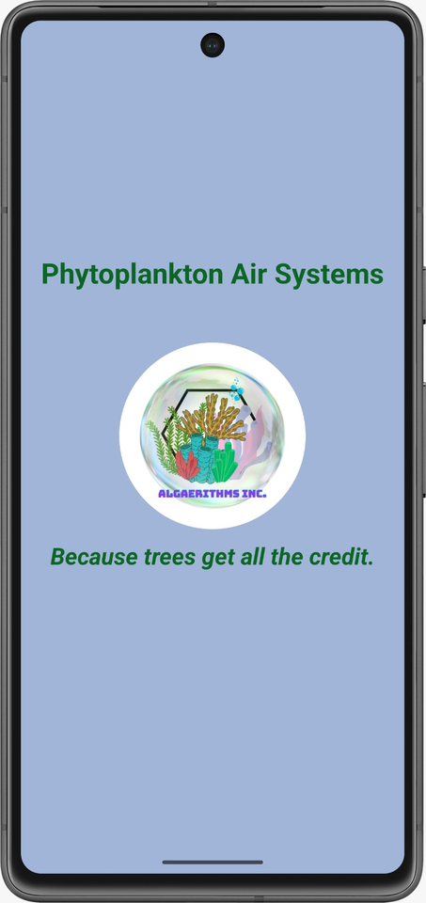
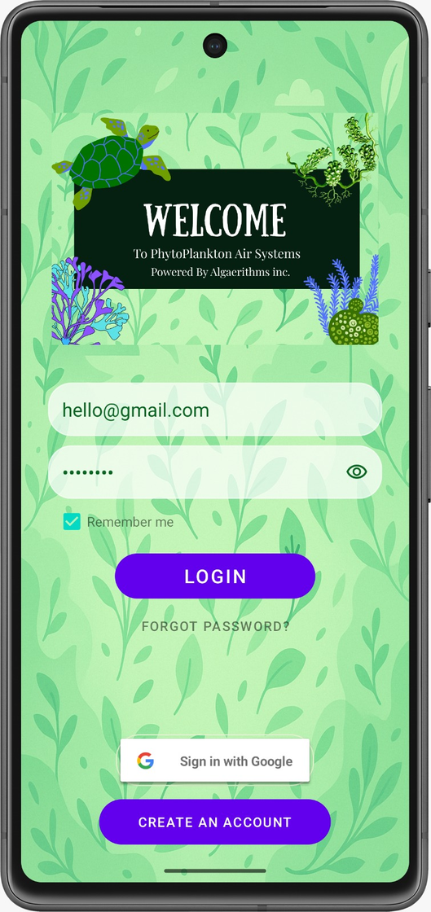
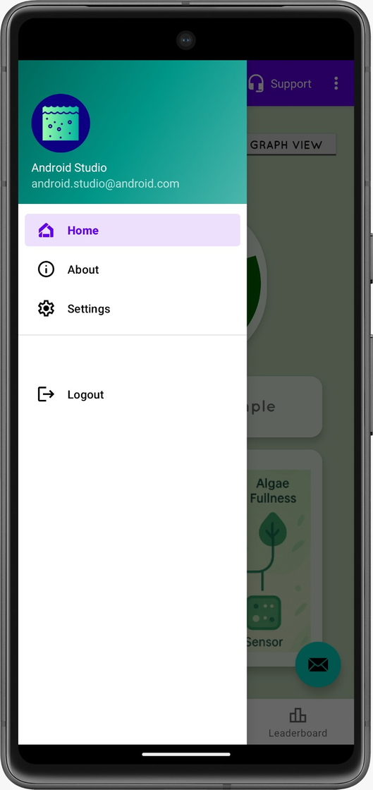
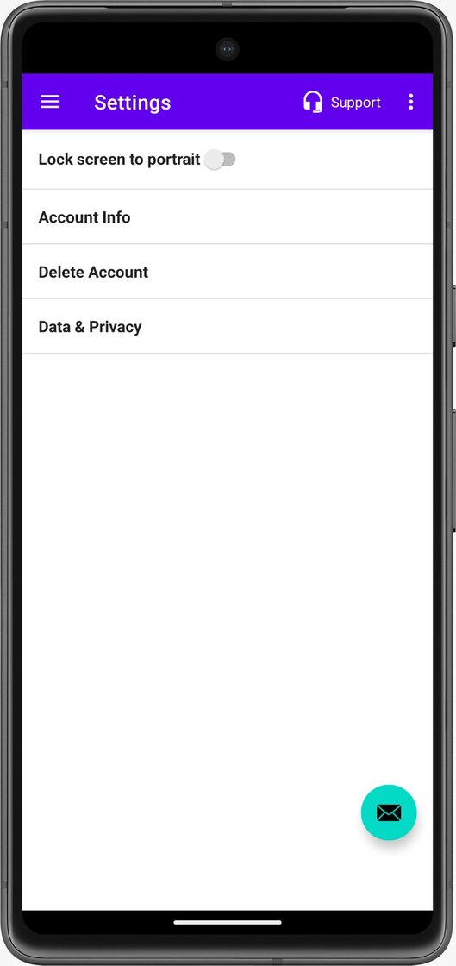
Demo Time – What It Looks Like Today

Slide 6
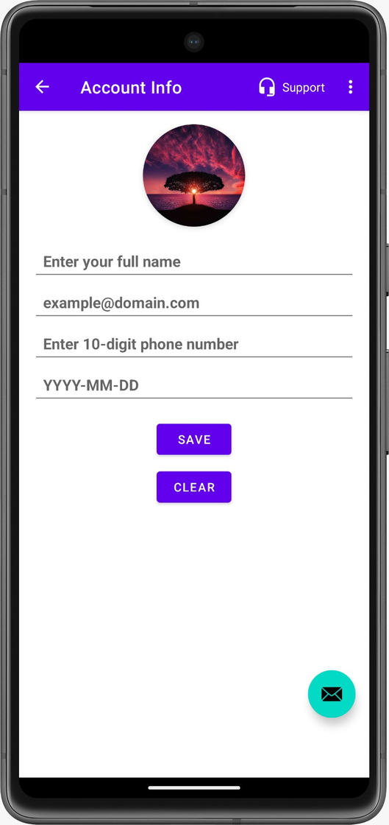
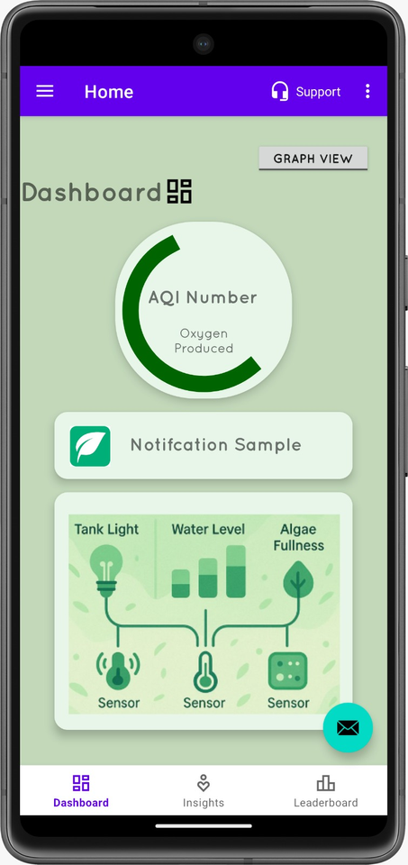
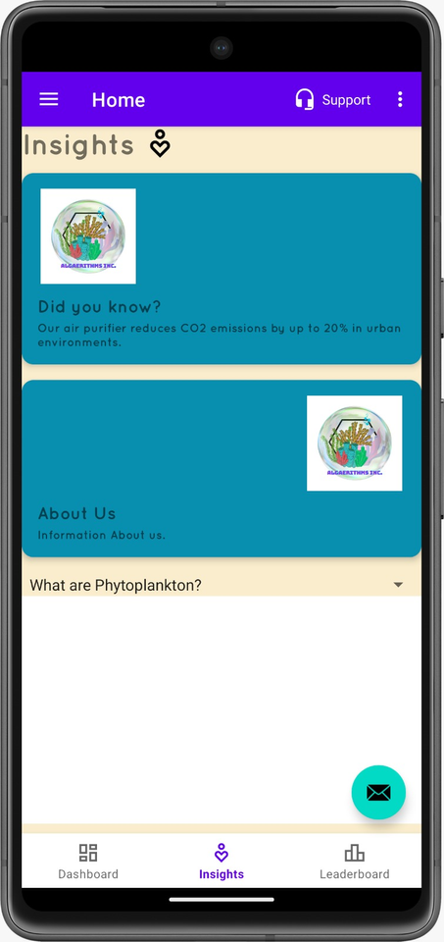
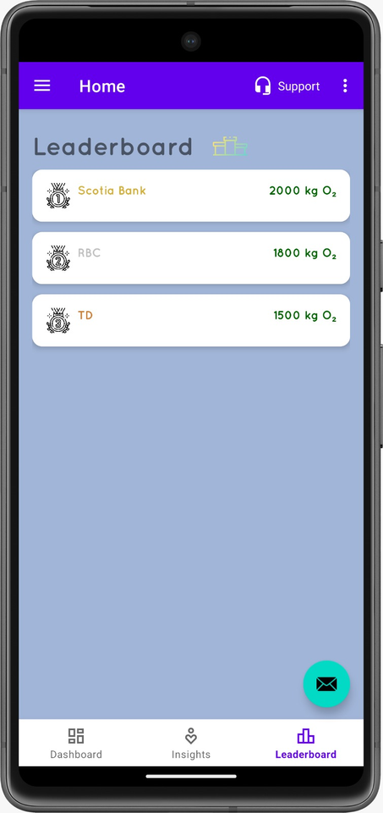
Demo Time – What It Looks Like Today

Slide 7
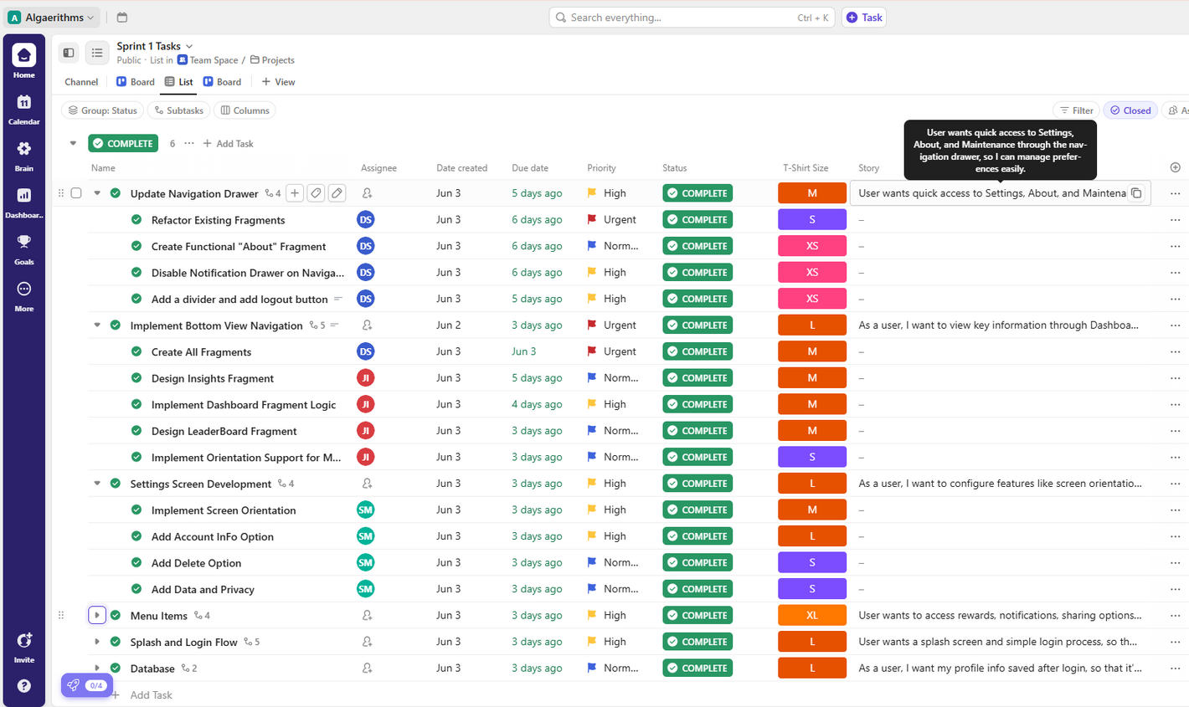
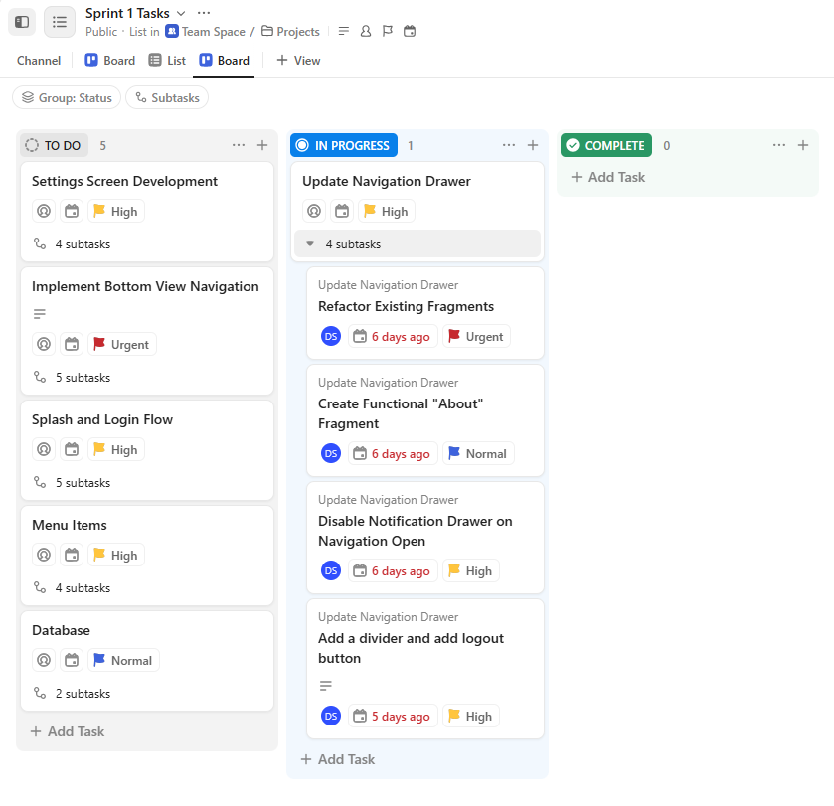
Driven by Sprints. Delivered by Synergy.
Sprint List
Notes:
Tshirt sizing
DoD
maybe include an example of one of the stories and the tasks within it

Slide 8
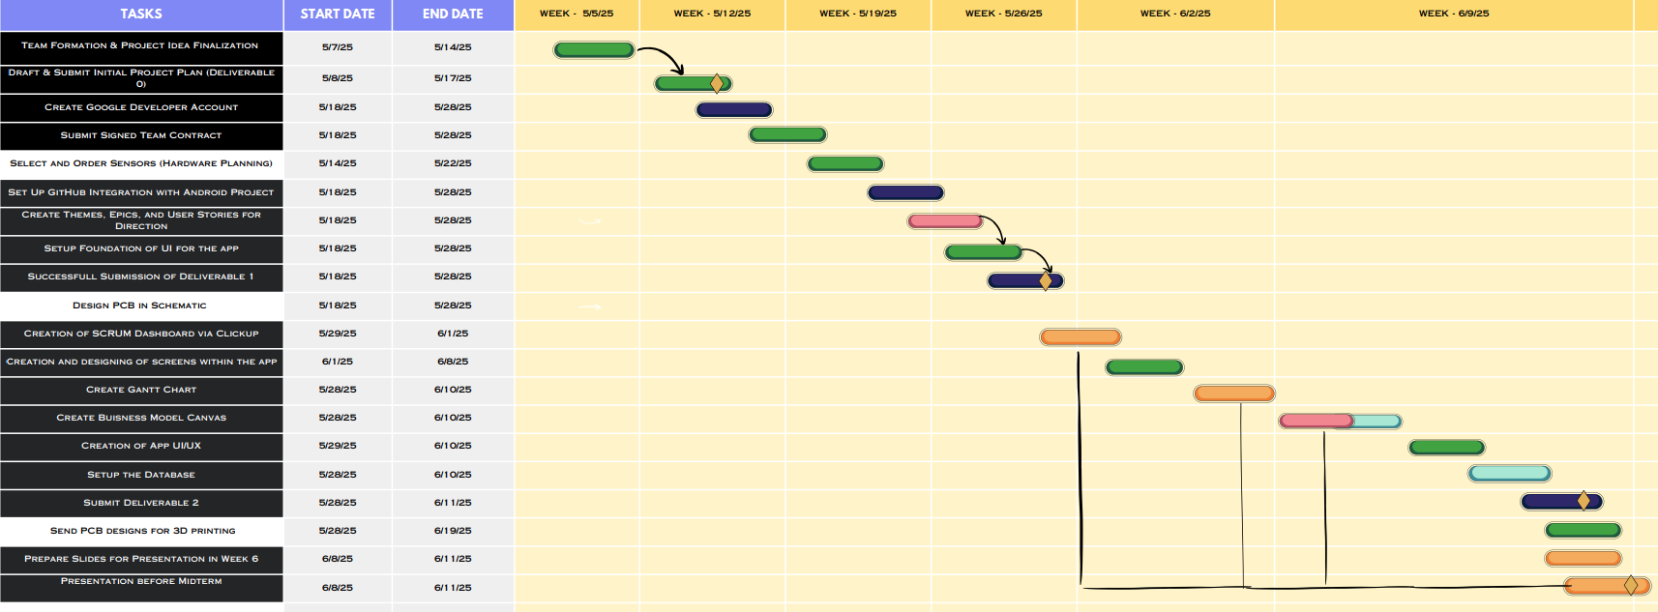
From Idea to Implementation — Our Gantt in Action
Gantt Chart Link

Slide 9

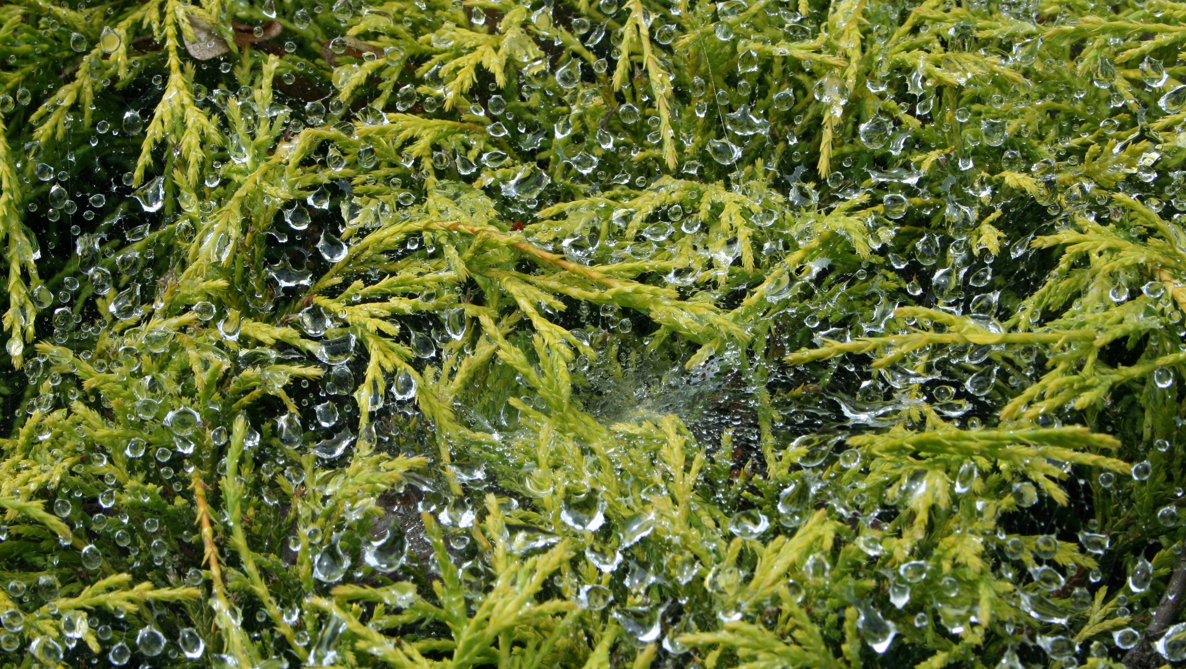


GITHUB
Notes:
Github workflow - every branch clones from master and then one branch = one feature. programmer_featureName
Pull requests are made and only I merge them to master after verifying the code.

Slide 10
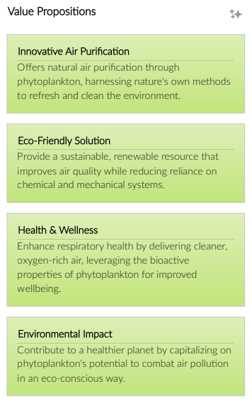
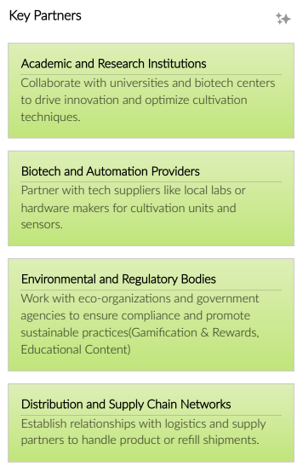
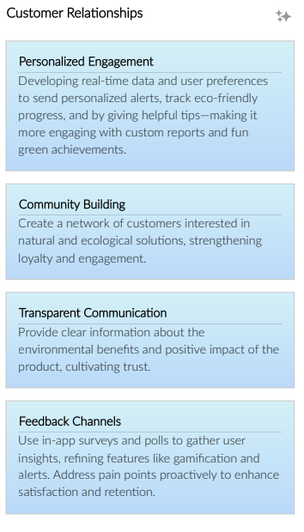
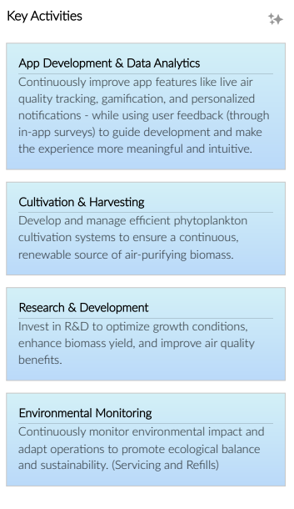
A Business Model That Scales With Nature
Business Model Canvas

Slide 11
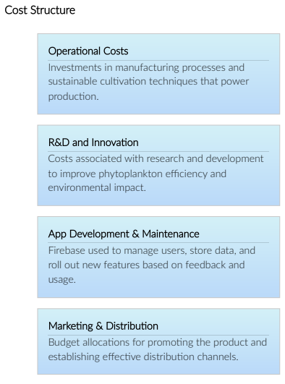
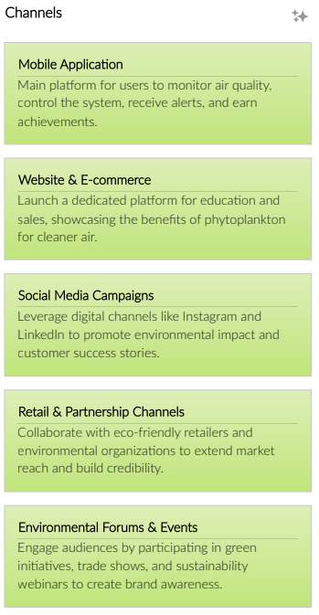
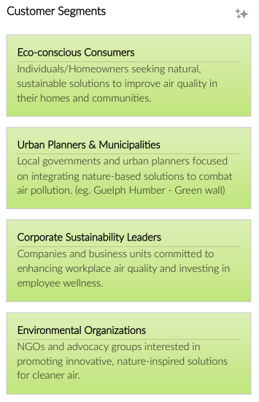
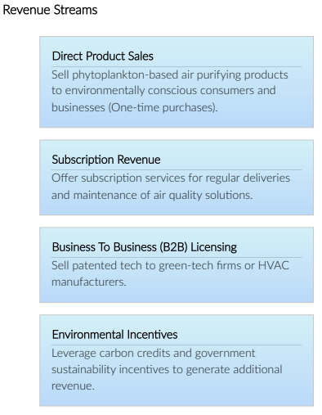
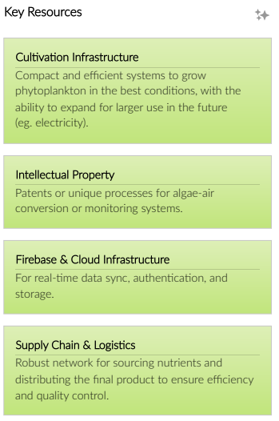
A Business Model That Scales With Nature

Slide 12
CENG322 Software Project
Thank you
Algaerithms Inc.

